Slide 1
FYP Literature Review
By Team: B7

Slide 2
Team Members:
Name | Roll
Nishanth | AM.EN.U4CSE17149
Vasanth Gopa | AM.EN.U4CSE17128
P Vamshi Krishna | AM.EN.U4CSE17152
P V S Sri Alavandar | AM.EN.U4CSE17150
P P Venkat Sai | AM.EN.U4CSE17151

Slide 3
Contents:
Sl_No | Paper | Link
1. | Performance Analysis of Various Video Compression Standards | https://ieeexplore.ieee.org/document/7955287
2. | Analysis of Video Compression Algorithms on Different Video Files | https://ieeexplore.ieee.org/document/6375112
3. | Development of Context Based Collaborative Filtering System for Recommendation | https://www.researchgate.net/publication/269280082_Development_of_Context_Based_Collaborative_Filtering_System_for_Recommendation

Slide 4
Contents:
Sl_No | Paper | Link
4. | A study on Content Based Video Recommendation. | https://ieeexplore.ieee.org/document/8297150
5. | A micro-video recommendation system based on big data | https://ieeexplore.ieee.org/document/7550932
6. | Deep Neural Networks for Youtube Recommendations | https://dl.acm.org/doi/10.1145/2959100.2959190

Slide 5
Contents:
Sl_No | Paper | Link
7. | Recommendation Engine for Online Short Video | https://ieeexplore.ieee.org/document/7917010
8. | Cloud Security Ecosystem for Data Security and Privacy | https://ieeexplore.ieee.org/abstract/document/7943164
9. | Overview Of Web Password Hashing Using Salt Technique | https://www.irjet.net/archives/V4/i11/IRJET-V4I1126.pdf

Slide 6
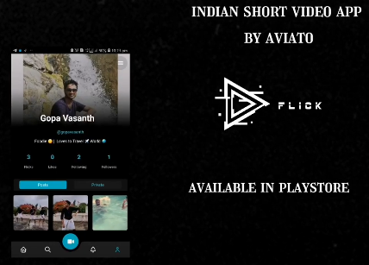

Look at our Short Video
https://youtu.be/tYSNsOrZRXw
(21 sec)

Slide 7
I
II
Video Compression
Recommendation Systems
Table of Contents
IV
III
Case Study
Crypto signings
Video recommendations in the newsfeed
Flick requires video compression techniques to reduce the size of the files.
Helps us to perform improve our project.
To secure the HTTP API’s securely in the client side

Slide 8
I
Video Compression

Slide 9
Performance Analysis of Various Video Compression Standards
https://ieeexplore.ieee.org/document/7955287

Slide 10
Summary
The paper describes the different video compression techniques for a better way of reducing video size with less quality loss which will be used in our application to save ton’s of the storage capacity.

Slide 11
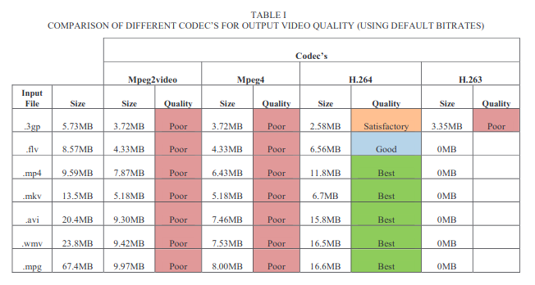
Comparison of different code’c for output video quality (Using default Bitrate)

Slide 12
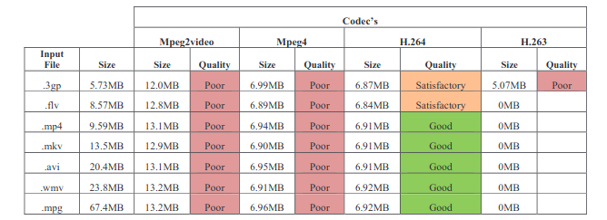
Comparison of different code’c for output video quality (Using bitrate of 320 kbits/s)

Slide 13
Limitations
This paper doesn’t compare with the built-in flutter compression packages with the H.264 results so we need to compare the performance measure manually and decide the better technique in the development phase.

Slide 14
Analysis of Video Compression Algorithms on different video files
https://ieeexplore.ieee.org/document/6375112

Slide 15
Summary
The paper performs the performance analysis of compression ratios with different types of video types (DAT, RMV, AVI, MP4, MKV, 3GP, WMV and FLV.)

Slide 16
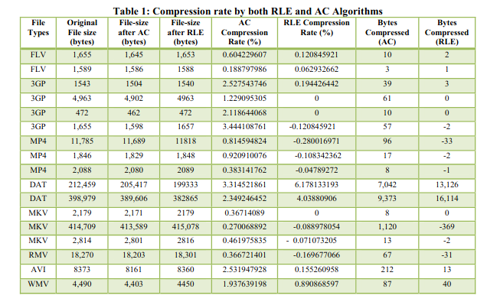
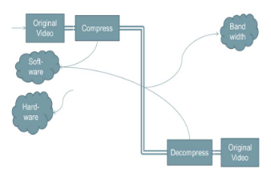
Compression rate by both RLE and AC Algorithms

Slide 17
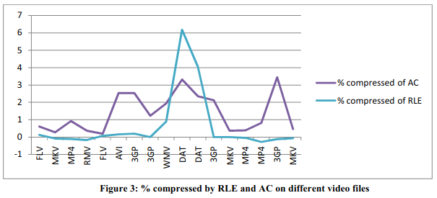
Conclusion
Compression factor in AC is better than RLE

Slide 18
Limitations
This paper compares two algorithms RLE (Run length Encoding) and AC (Arithmetic Coding) and doesn't compare the performance results of other popular compression techniques.

Slide 19
II
Recommendation Systems

Slide 20
Title: Development of Context Based Collaborative Filtering Recommender System.
Motivation and reason for selecting the paper:
This paper describes on how to personalize the short video recommendations for the app. It uses a technique called Collaborative Filtering which searches for similar user behaviors to give short video recommendations. Effective recommendations can improve user experience.
Takeaways:
Got to know about a technique called Collaborative filtering which matches the active user patterns with other user patterns and find similar users who share the same patterns as the current user and make accurate predictions according to it.

Slide 21
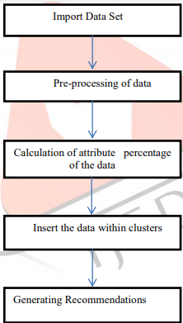
Title: Development of Context Based Collaborative Filtering Recommender System.
Flowchart of Algorithm used:
The experiment clusters users based
upon the user search patterns which
Includes attributes like tags, genres,
Etc. And then searches similar users
Who share the equivalent search
Patterns of the current user, and then
Make predictions on the fact that
Similar users share similar interests.

Slide 22
Title: Development of Context Based Collaborative Filtering Recommender System.
Limitations of the paper::
Collaborative filtering needs two important things:
Search patterns, video watching patterns, of the current user.
And then compare these patterns with other users to find out similar users with similar search patterns.
The limitation here is, if a user is completely new to the system, the system wouldn't have enough data about user to find similar users, this is what we called “Cold Start Problem”, So this approach would only work for users with active search trends.
Identified research gap and plans to fill it:
The usage of Collaborative filtering has the above limitations, So we put forth another method called Content based recommendations which makes predictions based on User interests rather than similar users.

Slide 23
Title: A STUDY ON CONTENT BASED VIDEO RECOMMENDATION
Motivation and reason for selecting the paper:
An important problem called Cold Start problem for Collaborative filtering approach, where for a brand new user won't have any search patterns to compare with the user base, so it would be difficult to give predictions. This paper puts forth a solution to tackle the cold-start problem.
Takeaways:
Got to know about the proposed methodology to tackle cold start problem is to make accurate recommendations based on ‘content’ of the video like tags, genres, audio, video etc.. and various other metadata, so less data is enough for accurate predictions.
As the user watches the first few videos the algorithms take the content metadata and start making recommendations.

Slide 24
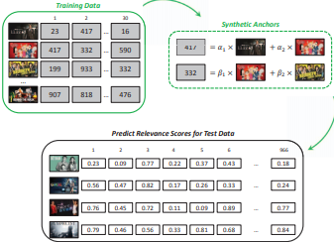
Title: A study on Content Based Video Recommendation.
Algorithm used:
Based on the videos which he sees, a
User profile will be created with tags and
Genres, and for new recommendations,
Synthetic anchors i.e, the weights for each
Given metadata like tags genres will be
Calculated. And this weight matrix will
Be used for predicting the recommendation
For users.

Slide 25
Title: A study on Content Based Recommender System.
Limitations of the paper::
The draw back of the Content Based Recommender Model is :
The model can only make recommendations based on existing interests of the user.
In other words, the model has limited ability to expand on the users' existing interests.
It can only make predictions based on the users current interests, like if the users watch only motivational videos, the recommender can't even recommend a comedy video, which the user might like.
Identified research gap and plans to fill it:
The usage of Content based recommendation has the above limitations, current trends like big data can be used to tackle the problem which is lacking in this research, usage of tools like hadoop can encourage increasing the amount of data used to make predictions.

Slide 26
Title: A Micro Video Recommendation System Based on Big Data.
Motivation and reason for selecting the paper:
For micro-video producers, the problem is they do not know how many people like their products, and do not know how many times their video have been watched. Therefore, this paper proposes a micro-video recommendation system (MRS). One of the purposes of MRS is an overview of micro-videos for the producer. So that users will be recommended videos from the producers who make similar content.
Takeaways:
Got to know about two new techniques called Slope One Algorithm and Map Reduce Algorithm. The former recommends videos by making clusters of user watched videos, and recommends by finding similar videos by cosine similarity, while the latter splits the data into n parts and makes n mappings of data and the reduces the mappings made finding another mappings to new data and finding similarity with original data.

Slide 27
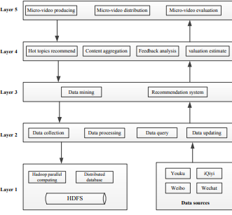
Title: A study on Content Based Video Recommendation.
Algorithm used:
L1 : Data source is the basic of MRS,
So downloading data and processing in
Hadoop
L2: Layer 2 is data interface layer, which
contains data collection, data processing,
data query, and data updating.
L3:Core parts of this system, including
data mining algorithms, recommendation
Algorithms.
L4: The layer 4 has two main functions.
One of them is push recommend videos to user
Other is to hot topic recommendation to
Producer
L5: The layer 5 is the interface layer for users.
This layer contains interfaces for applications.

Slide 28
Title: A study on Content Based Recommender System.
Limitations of the paper::
The only drawback of this approach is that, as the number of videos increase in the database, the time complexity and the space complexity of this algorithm can increase rapidly.
Identified research gap and plans to fill it:
With the development of Big Data, the recommendation algorithms should have the ability to deal with the Big Data. So the time and space complexity wouldn’t be a big issue, So this research is quite latest in the area of recommendation systems as some short video apps like Welbo, Youku, iQiyi etc are using this technology for their recommendation.

Slide 29
Deep Neural Networks for Youtube Recommendations
-Paul Covington, Jay Adams, Emre Sargin
https://dl.acm.org/doi/10.1145/2959100.2959190

Slide 30
Why this Paper?
The problem discussed in this paper is to get recommended videos based on user interest with best accuracy.

Slide 31
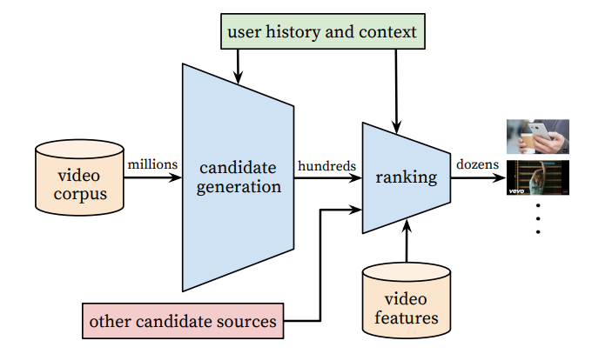
System Overview

Slide 32
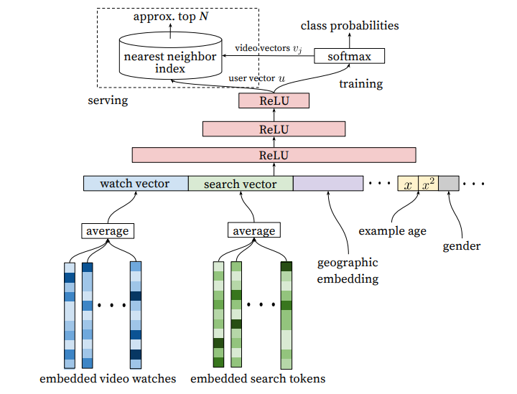
Candidate Generation
99% of learnable parameters.
Embeddings are formed via backpropagation
Append more features

Slide 33
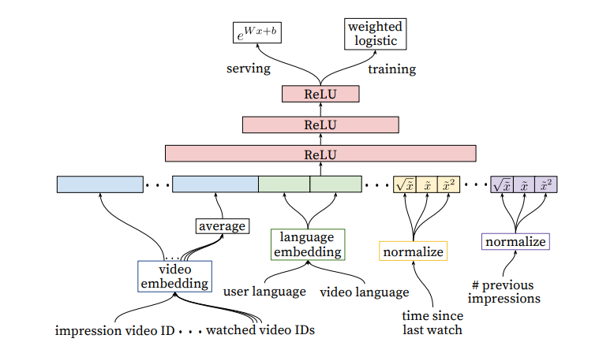
Ranking
ReLU for Computations
Weighted Logistic

Slide 34
Limitations:
Adding more features to the model as users interact with similar items.
Time since the last impression of video.
Number of watches by the user on the channel.

Slide 35
Recommendation Engine for online short video
-Nan Yang, Sanxing Cao,Yu Liang, Zhengzheng Liu
The problem addressed in this deals with recommendation engine design for online short videos using content based filtering and collaborative filtering.
https://ieeexplore.ieee.org/document/7917010

Slide 36
TakeAways
Content Based Approach Vs Collaborative Filtering.
Collaborative Filtering
Memory based CF technique.
Model based CF technique.
Memory based CF technique
User based CF filtering algorithm.
Item-based CF filtering algorithm.
Similarity and top N-recommendations.
Recommendation evaluation.

Slide 37
Limitations:
Improve the current algorithms for scenarios like Neighbors predictions that are based on very few overlapping videos.

Slide 38
III
Crypto signings

Slide 39
Overview of web Password Hashing using salt Technique
Diksha.S.Borde, Poonam.A.Hebare, Priyanka.D.Dhanedhar

Slide 40
Motive of this paper
This paper mainly deal with the user main and critical information which should not be even revealed with the organization and stored databases in a raw format

Slide 41
Hashing
Hashing is a one way encryption which cannot be decrypted
Hashing mainly used for user integrity
Even the password file is compromised then even the user integrity is not compromised

Slide 42
Algorithms used in hashing
Md5
SHA-1 & SHA-2
Bcrypt
Scrypt

Slide 43
Salting method
Generate a unique salt using a pseudo random generator
Hash it using (Password + salt)
Store the salt and hash in the database

Slide 44
Limitations
Salt reuse
Short salt

Slide 45
Cloud Security Ecosystem for Data Security and Privacy

Slide 46
Motive of this paper
The main motive of this paper is build a secure cloud ecosystem using cryptographic algorithms and multi level hashing and salting

Slide 47
Levels of security measure
Username and password
Multi factor authentication
Data transmission
Data encryption

Slide 48
Security concerns
Data protection
Loss of data
Traffic hijacking
Isolation of resources
Malicious insider

Slide 49
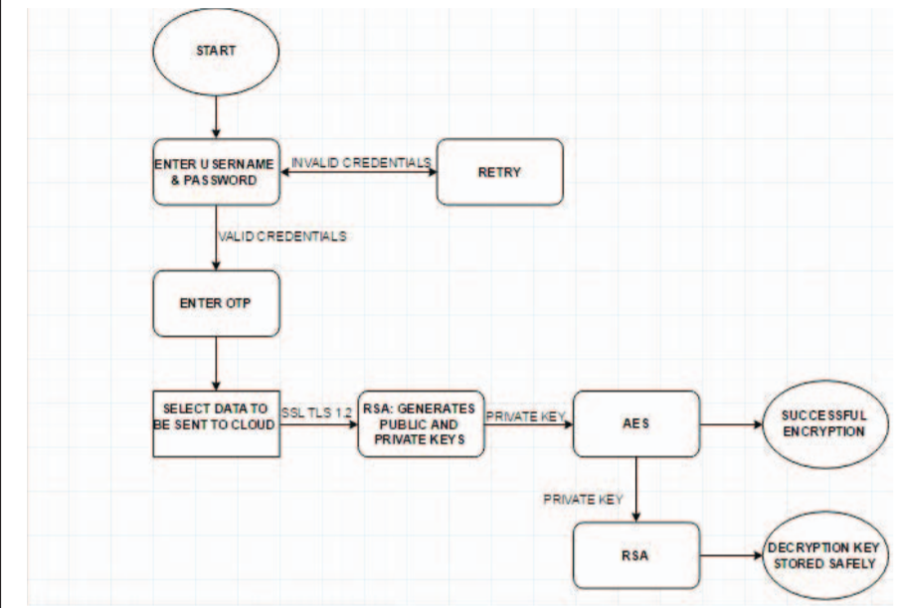
Data encryption

Slide 50
Core Algorithm
STEP 1: Create Username and Password
STEP 2: Password creation using CSPRNG
STEP 3: SHA512 and bcrypt function used for password protection
STEP 4: Enter login credentials
STEP 5: Make use of OTP for multi factor authentication. Validity of OTP is 5 minutes.
STEP 6: SSL and TLS 1.2 are used for conducting transfer user data over the network

Slide 51
Core Algorithm
STEP 7: RSA algorithm is used for Public Private Key generation
STEP 8: AES algorithm encrypts data using RSA Private Key
STEP 9: Private Key encrypted using RSA
STEP 10: User request to access data
STEP 11: RSA generates Decryption Keys
STEP 12: Decryption process takes place

Slide 52
CASE STUDY

Slide 53
Research on User Loyalty of Short Video App Based on Perceived Value

Slide 54
Motive of this paper
Despite short video industry has been greatly developed in recent years and many people have been addicted to using short video apps, little is known about what motivates users to generate such loyalty. The purpose of this paper is to build a research model based on the satisfaction, perceived value, time-flexibility, ease of use and celebrity attractiveness to identify the antecedents of users' loyalty in the context of short videos. The model is tested against 278 actual users of Tik Tok.

Slide 55
Key Parameters
Structural equation modeling (SEM) is employed for data analysis. The findings put entertainment value, social value, perceived usefulness, and time-flexibility under the spotlight, but the ease of use and celebrity attractiveness don't support our hypotheses. We conclude that Tik Tok users' loyalty is strongly driven by satisfaction, which in turn is primarily driven by the perceived value and weaken by the time-flexibility.

Slide 56
A Study on the Characteristics of Douyin Short-Videos and Implications for Edge Caching

Slide 57
Motive of this paper
Douyin is a mobile short video platform with powerful editing capabilities, which enables users to add various types of music and effects on their videos. The length of Douyin videos is restricted to 15 seconds, which makes them more attractive. Understanding the characteristics of Douyin videos is thus critical to its service improvement and system design.

Slide 58
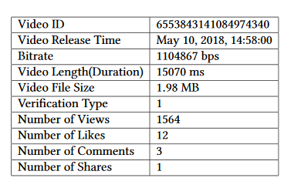
Douyin assigns a distinct 19-digit decimal ID for eachvideo. Each video contains the following meta-data: videoID, the time when it was released, bitrate which is the play bitrate of each video, video length, which is the play duration of each video, video file size that is one of the key metrics for caching, verification type that indicates whether the user who uploaded the video, has passed the official certification of Douyin, number of views and number of likes, number of comments and number of shares.

Slide 59
Conclusion
We studied latest short videos from Douyin in terms three basic fundamental features and four popularity metrics. First,we studied how Douyin works and found out that it is a decentralized video social media based on massive short videos and a strong recommendation mechanism. Second, we studied the characteristics of Douyin videos and found out that the distributions of the bitrate and the size of videos closely follow Weibull distribution. Third, we analyzed distributions of different popularity metrics and discovered that the popularity metrics of the most popular Douyin videos obey Zipf distribution, but rest of the videos do not, which is the case with traditional videos. We also analyzed the relationships of key popularity metrics and figured out that four of them are not highly correlated, except the relationship between the number of views and the number of likes.

Slide 60

Thanks!
Do you have any questions?
Please keep this slide for attribution.

